Slide 1
Lecture1

Slide 2

Chapter 5 :
DATA HANDLING

Slide 3
Module 1

Slide 4
What is Statistics ?
Collection of the data
Presentation of the data
Analysis
Conclusion

Slide 5

Any information given is called data

Slide 6
Numerical Presentation
Arranging Data in Ascending or Descending order
Ungrouped frequency Distribution table
Grouped frequency Distribution table
Age in Years | Frequency
12 | 9
13 | 6
14 | 3
15 | 0
16 | 2
Age in Years | Frequency
0 – 10 | 9
10 – 20 | 6
20 – 30 | 3
30 – 40 | 0
40 – 50 | 2

Slide 7
Module 2

Slide 8
For e.g.
Ungrouped Frequency Distribution Table
Ages of some students are collected as follows :
13,
12,
13,
12,
13,
12,
14,
12,
14,
12,
13,
12,
13,
12,
14,
13
Find the smallest number
Find the biggest number
Age in years
Tally Marks
Frequency
In the tally marks column we put sticks
like this
Frequency is number of tally marks we put
In the first column we write all the numbers in the data starting from the smallest to the biggest once only.
12
7
13
6
We make a set of 5 this way
14
3
Total (N)
16

Slide 9
Q.
The shoppers who come to a departmental store are marked as:
man (M), woman (W), boy (B) or girl (G). The following list gives the
shoppers who came during the first hour in the morning.
Make a frequency distribution table using tally marks.
Draw a bar graph to illustrate it.
W W W G B W W M G G M M W W W W G B M W
B G G M W W M M W W W M W B W G M W W W
W G W M M W M W G W M G W M M B G G W W
Sol:
The frequency distribution table is as follows:
Shopper
Tally Marks
Number of shoppers
M
15
W
28
B
5
G
12
Total
60

Slide 10
Module 3

Slide 11


Q.
The shoppers who come to a departmental store are marked as:
man (M), woman (W), boy (B) or girl (G). The following list gives the
shoppers who came during the first hour in the morning.
Make a frequency distribution table using tally marks.
Draw a bar graph to illustrate it.
Scale :
Y
On Y axis :
1cm = 2 Shoppers
Sol:
1
2
3
4
5
6
7
8
9
10
11
12
13
14
15
30
The frequency distribution
table is as follows:
28
26
Shopper
Number of shoppers
24
22
M
15
20
18
1
2
3
4
5
6
7
8
9
10
11
12
13
14
15
W
No. of Shoppers
28
16
1
2
3
4
5
14
B
5
12
G
12
10
8
1
2
3
4
5
6
7
8
9
10
11
12
13
14
15
Total
60
6
4
1
2
3
2
7
9
1
4
3
5
6
8
7
8
9
4
5
6
10
11
12
13
14
15
2
10
11
12
13
14
15
X`
0
M
W
B
G
X
Y`
Shoppers
1
2
1
3
2
4
3
5
4
6
5
7
6
8
7
9
8
9
10
11
10
12
11
13
12
14
13
15
14
15
1
2
1
3
2
4
3
5
6
7
8
7
9
10
11
12
13
14
15
4
5
6
8
9
10
11
12
13
14
15
1
2
1
3
2
4
3
5
6
7
8
7
9
10
11
12
13
14
15
4
5
6
8
9
10
11
12
13
14
15

Slide 12
Module 4

Slide 13
Grouped frequency Distribution Table
For e.g. 1-10, 10 -20 etc. each one i.e. 1-10, 10-20, 20-30 is called as a class.
every class has its own lower limit and its own upper limit.
29, 4, 12, 25, 14, 13, 21, 5, 3, 24, 2, 10, 15, 28, 19, 12, 27, 16, 14, 1.
In the first column, the data is classified into small groups each group is called as a class.
These classes are called continuous classes.
When the classes are continuous we exclude upper limit.
Class ( Marks obtained)
Tally Marks
Frequency
i.e. for class 0-10, 10 is the upper limit. Hence, data 10 is recorded in the next class 10-20.
Same
0 – 10
5
10 – 20
9
20 – 30
6
Total
20

Slide 14
Module 5

Slide 15
Q.
The weekly wages (in Rs.) of 30 workers in a factory are:
Using tally marks, make a frequency table with intervals as
800 – 810, 810 – 820 and so on.
830, 835, 890, 810, 835, 836, 869, 845, 898, 890, 820, 860, 832, 833, 855, 845, 804, 808, 812, 840, 885, 835, 835, 836, 878, 840, 868, 890, 806, 840.
Sol:
The frequency distribution table is as follows:
Class Intervals
Tally Marks
Frequency
800 – 810
3
810 – 820
2
820 – 830
1
830 – 840
9
840 – 850
5
850 – 860
1
860 – 870
3
870 – 880
1
880 – 890
1
890 – 900
4
Total
30

Slide 16
Module 6

Slide 17
HISTOGRAM
Y
Histogram is a series of joint rectangles to
represent continuous frequency distribution.
10
9
Classes are continuous
8
For e.g. :
i.e. upper limit = lower limit of preceding class
7
No. of workers
6
Wages (in `)
No. of workers
Let us have an numerical example of continuous frequency distribution
5
It means there is no gap between upper limit and lower limit of proceeding class
4
6500 - 7000
6
3
7000 - 7500
8
2
1
X
7500 - 8000
10
X′
0
6500
7000
7500
8000
8500
8000 - 8500
4
Y′
Wages in

Slide 18
To draw a histogram :
Class should be continuous
CLASSES
Discontinuous Classes
Continuous Classes
Not same
1 - 10
Same
0 - 10
11 - 20
10 - 20
21 - 30
20 - 30

Slide 19


To draw histogram :
Y
Scale :
Class should be continuous
Draw X axis and Y axis
Scale
Frequency on Y axis
Frequency
Maximum frequency | Ideal Scale for Y axis
Up to 20 | 1 cm = 1 unit
Up to 40 | 1 cm = 2 units
Class Interval on X axis
0
X’
Class Interval
X
Y’

Slide 20
To draw histogram :
Scale :
Y
Scale :
On X axis:2cm = 5 cm height
This mark is called as ‘Krink’ mark
On Y axis:1 cm = 1 student
Frequency
9
8
7
6
No. of students
5
4
3
2
1
0
140
145
150
155
160
165
X’
Class Interval
X
Y’
Height of students in cm

Slide 21

Q.
For which of these would you use a histogram to show the data:
✗
(a) The number of letters for different areas in a postman’s bag.
✓
(b) The height of competitors in an athletics meet.
✗
(c) The number cassettes produced by 5 companies.
✓
(d) The number of passengers boarding trains from 7.00
a.m. to 7.00 p.m. at a station.
In case (a) and (C)
The given data cannot
be divided into class interval
Give reason for each.
Sol:
Area
No. Of letters
Company
No. of cassettes
Height of competitors
(in cm)
Number of competitors
Train timings
Number of passenger
Case (b) :
Data (height of competitors) can be
divided into class intervals on X axis. Hence we can represent the data using Histogram.
A₁
15
C₁
200
160 - 170
15
A₂
10
C₂
7 - 8
15
400
170 - 180
10
A₃
8
C₃
8 - 9
10
Case (d) :
700
Data (Boarding timings – 7 am to 7 pm)
can be divided into class intervals.
Hence we can represent the data using Histogram.
180 - 190
8
A₄
C₄
9 - 10
8
20
500
190 - 200
10 - 11
20
A₅
30
C₅
150
20
Histogram is a graphical representation of data, if data represented in manner of class-interval.

Slide 22
Module 7

Slide 23

Q.
Draw a histogram for the frequency table given below and
answer the following questions.
(i) Which group has the maximum number of workers?
(ii) How many workers earn Rs. 850 and more?
(iii) How many workers earn less than Rs. 850?
Since difference is not same we will put krink mark on X-axis
Scale :
Y
On X axis : 1cm = 10 Rs.
Wages in Rs.
No. of workers
10
On Y axis : 1cm = 1 worker
800 – 810
3
9
Check the difference between first limit and ‘0’
810 – 820
2
8
Also between second and first limit
820 – 830
1
7
830 – 840
9
6
800
–
0
=
800
No. of workers
800
810
–
800
=
10
840 – 850
5
5
10
850 – 860
4
1
2
3
4
5
6
7
8
9
10
11
12
13
14
15
1
860 – 870
3
3
1
2
3
4
5
6
7
8
9
10
11
12
13
14
15
870 – 880
1
2
1
2
3
4
5
6
7
8
9
10
11
12
13
14
15
1 cm
1 cm
880 – 890
1
1
890 – 900
4
2
1
3
4
5
6
7
8
9
0
10
11
12
13
14
15
0
1
2
3
4
5
6
7
8
9
10
11
12
13
800
810
820
830
840
850
X`
800
810
860
870
880
890
900
X
Total
30
Y`
Wages in Rs.
1
2
3
4
5
6
7
8
9
10
11
12
13
14
15
1
2
3
4
5
6
7
8
9
10
11
12
13
14
15
1
2
3
4
5
6
7
8
9
10
11
12
13
14
15
1
2
3
4
5
6
7
8
9
10
11
12
13
14
15
1
2
3
4
5
6
7
8
9
10
11
12
13
14
15
1
2
3
4
5
6
7
8
9
10
11
12
13
14
15

Slide 24
Module 8

Slide 25
Q.
Draw a histogram for the frequency table given below and
answer the following questions.
(i) Which group has the maximum number of workers?
(ii) How many workers earn Rs. 850 and more?
(iii) How many workers earn less than Rs. 850?
=
1 + 3 + 1 + 1 + 4
10
Sol:
Scale :
Y
On X axis : 2cm = 10 `
(i) 830 – 840 group has the
maximum number of workers.
10
On Y axis : 1cm = 1 worker
9
9
8
(ii) 10 workers can earn more than
Rs. 850.
7
6
(iii) 20 workers earn less than
Rs.850.
No. of workers
5
5
4
4
3
3
3
2
2
=
5 + 9 + 1 + 2 + 3
20
1
1
1
1
1
X`
0
800
810
820
830
840
850
860
870
880
890
900
X
Y`
Wages in `

Slide 26
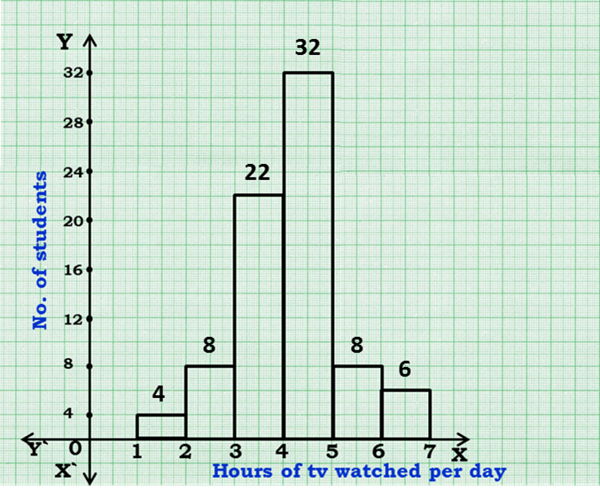
Q.
The number of hours for which students of a particular class watched television during holidays is shown through the given graph. Answer the following:
(i) For how many hours did the maximum number of students watch T.V.?
(ii) How many students watched TV for less than 4 hours?
(iii) How many students spent more than 5 hours in watching TV?
Sol:
The maximum number of students
watched T.V. for 4 – 5 hours.
(ii) 34 students watched T.V. for less
than 4 hours.
4 + 8 + 22 = 34
(iii) 14 students spent more than 5 hours
in watching T.V.
8 + 6 = 14

Slide 27
Lecture2

Slide 28
Module 9

Slide 29

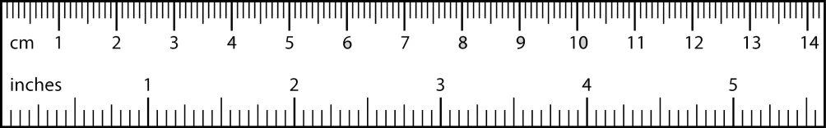
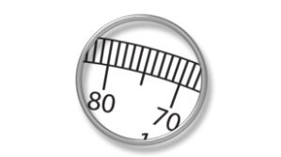
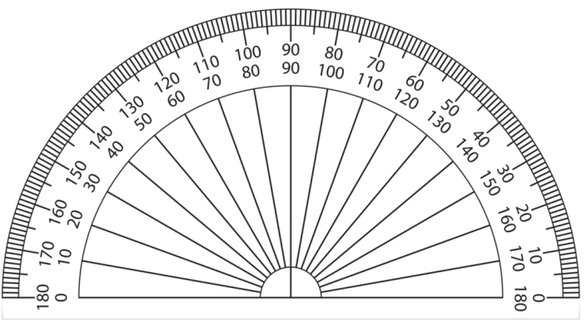

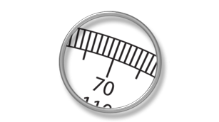

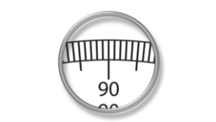
PIE DIAGRAM
In pie diagram whatever information is given is put in a circle.
The total angle of a circle 360⁰ is broken into sectors based on measure
of central angle.
data
Measure of central angle (θ)
=
×
360º
total
70º
75º
125º

Slide 30


Q.
A group of 360 people were asked to vote for their favourite
season from the three seasons rainy, winter and summer.
(i) Which season got the most votes?
(ii) Find the central angle of each sector.
(iii) Draw a pie chart to show this information.
Seasons
Summer
Rainy
Winter
Total
Data
Central Angle =
×
No. of votes
90
120
150
360
Total
360°
90
150
Sol:
(i) Winter season got the most votes
120
360
∴ Central Angle =
×
360
360
×
360
×
360
360
(ii)
Seasons
No. of votes
Central Angles
Summer
90
?
90
90°
?
Rainy
120
120°
?
Winter
150
150°
360
Total
360
360°

Slide 31
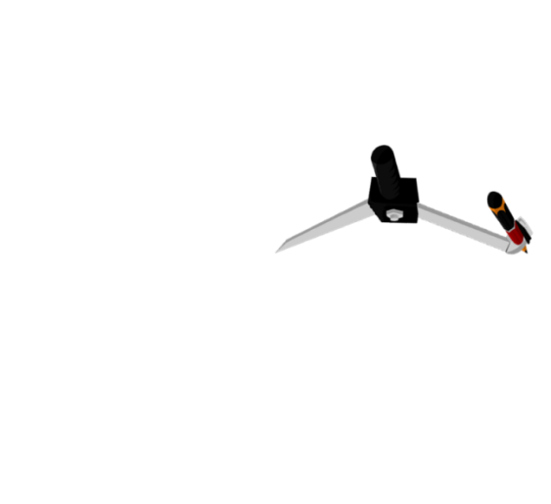



Q.
A group of 360 people were asked to vote for their favourite
season from the three seasons rainy, winter and summer.
(i) Which season got the most votes?
(ii) Find the central angle of each sector.
(iii) Draw a pie chart to show this information.
Seasons
Summer
Rainy
Winter
Total
No. of votes
90
120
150
360
Sol:
(i) Winter season got the most votes
1
2
3
4
5
6
7
8
9
10
11
12
13
14
15
(ii)
Summer
Seasons
No. of votes
Central Angles
Summer
90
90°
120°
Rainy
1
2
3
4
5
6
7
8
9
10
11
12
13
14
15
Rainy
120
120°
1
2
3
4
5
6
7
8
9
10
11
12
13
14
15
150°
Winter
Winter
150
150°
1
2
3
4
5
6
7
8
9
10
11
12
13
14
15
Total
360
360°

Slide 32
Module 10

Slide 33
Q.
Draw a pie chart showing the following information.
The table shows the colours preferred by a group of people.
Colours
Blue
Green
Red
Yellow
Total
Number of people
18
9
6
3
36
Data
Central Angle =
×
Total
360°
Sol:
18
6
9
∴ Central Angle =
3
×
10
36
360
Colours
No. of People
Central Angles
=
90°
180°
60°
?
30°
Blue
18
18
180°
?
Green
9
90°
Red
6
?
60°
?
Yellow
3
30°
36
Total
36
360°

Slide 34

Q.
Draw a pie chart showing the following information.
The table shows the colours preferred by a group of people.
Colours
Blue
Green
Red
Yellow
Total
Number of people
18
9
6
3
36
Sol:
1
2
3
4
5
6
7
8
9
10
11
12
13
14
15
Colours
No. of People
Central Angles
Blue
Blue
18
180°
180°
Green
9
90°
30°
1
2
3
4
5
1
6
2
7
3
8
4
9
5
6
7
12
8
9
10
11
12
13
14
15
Yellow
10
11
13
14
15
Red
6
60°
Green
60°
Red
Yellow
3
30°
Total
36
360°
1
2
3
4
5
6
7
8
9
10
11
12
13
14
15
1
2
3
4
5
6
7
8
9
10
11
12
13
14
15

Slide 35
Module 11

Slide 36
Q.
The number of students in a hostel, speaking different
languages is given below. Display the data in a pie chart.
Language
Hindi
English
Marathi
Tamil
Bengali
Total
No. Of Students
40
12
9
7
4
72
Sol:
Language
No. of Students
Central angle
Hindi
40
?
Data
40
200°
Central Angle =
×
Total
360°
?
English
12
60°
∴ Central Angle =
40
5
12
9
7
∴ Central Angle =
4
×
360
?
72
Marathi
9
45°
1
=
200°
60°
45°
20°
35°
?
Tamil
7
35°
Bengali
4
?
20°
Total
72
360°
72

Slide 37



Q.
The number of students in a hostel, speaking different
languages is given below. Display the data in a pie chart.
Language
Hindi
English
Marathi
Tamil
Bengali
Total
No. Of Students
40
12
9
7
4
72
Sol:
Language
No. of Students
Central angle
Marathi
1
2
3
4
5
6
7
8
9
10
11
12
13
14
15
Tamil
Hindi
40
200°
60°
Bengali
35°
45°
English
12
20°
English
60°
Marathi
9
45°
1
2
3
4
5
6
7
8
9
1
2
3
4
5
6
7
8
9
10
11
12
13
14
15
10
11
12
13
14
15
35°
1
2
3
4
200°
7
8
9
Tamil
7
5
6
10
11
12
13
14
15
1
2
3
4
Hindi
7
8
9
Bengali
4
5
6
10
11
12
13
14
15
20°
1
2
3
4
5
6
7
8
9
10
11
12
13
14
15
Total
72
360°

Slide 38
Module 12

Slide 39
Q.
The following data relates to the cost of construction of a house in Delhi.
Draw a pie – diagram to represent the above.
Items
Cement
Steel
Bricks
Timber
Labour
Miscellaneous
Expenditure
30%
10%
10%
15%
25%
10%
Items
Expenditure
Central angle
?
Data
Central Angle =
×
Cement
30%
360°
30%
108⁰
Total
5
18
3
18
30
10
15
?
25
×
∴ Central Angle =
360
×
Steel
10%
36⁰
360
10%
100
100
100
100
5
?
2
Bricks
10%
10%
36⁰
=
108°
90°
36°
54°
?
Timber
15%
54⁰
15%
Labour
25%
?
25%
90⁰
?
Miscellaneous
10%
36⁰
10%
Total
100%
360⁰
100%

Slide 40



Q.
The following data relates to the cost of construction of a house in Delhi.
Draw a pie – diagram to represent the above.
Items
Cement
Steel
Bricks
Timber
Labour
Miscellaneous
Expenditure
30%
10%
10%
15%
25%
10%
Items
Expenditure
Central angle
Cement
30%
108⁰
1
2
3
4
5
6
7
8
9
10
11
12
13
14
15
Steel
10%
36⁰
Steel
Cement
Bricks
10%
36⁰
Bricks
36°
108°
36°
Timber
15%
54⁰
36°
Miscell-
aneous
1
2
3
54°
1
2
7
3
8
4
9
5
6
7
8
9
4
5
6
12
10
11
12
13
14
15
10
11
13
14
15
1
2
3
4
Timber
7
8
9
5
6
Labour
10
11
12
13
14
15
Labour
25%
90⁰
Miscellaneous
10%
36⁰
1
2
3
4
5
6
7
8
9
10
11
12
13
14
15
Total
100%
360⁰
1
2
3
4
5
6
7
8
9
10
11
12
13
14
15
100%
1
2
3
4
5
6
7
8
9
10
11
12
13
14
15

Slide 41
Module 13

Slide 42
Q.
The adjoining pie chart gives the marks scored
in an examination by a student in Hindi, English,
Mathematics, Social Science and Science.
If the total marks obtained by a student was 540,
answer The following questions:
(i) In which subject did the student score 105 marks?
(ii) How many more marks were obtained
by the student in Mathematics than in Hindi?
(iii) Examine whether the sum of the marks obtained
in Social Science and Mathematics is more than
that in Science and Hindi.
Mathematics
S.Science
90°
65°
80°
55°
Science
English
70°
Hindi

Slide 43
Q.
The adjoining pie chart gives the marks scored in an examination by a student in Hindi, English, Mathematics, Social Science and Science.
If the total marks obtained by a student was 540, then answer the foll. questions:
(i) In which subject did the student score 105 marks?
Subjects
Mathematics
Social Science
Science
Hindi
English
Total
Mathematics
S.Science
Central angles
90°
65°
80°
70°
55°
360
90°
65°
Subjects
Central angle
Marks Obtained
Data
80°
Central Angle =
55°
Science
×
Total
360°
?
English
70°
Mathematics
90°
90°
135
Data
2
Hindi
360
∴
90
=
×
70
55
65
80
540
?
3
Social Science
65°
97.5
70
3
90
×
80
65
?
∴ Data =
55
Science
80°
120
2
=
135
82.5
120
97.5
105
?
Hindi
70°
105
English
55°
?
82.5
Total
540
360°
540

Slide 44
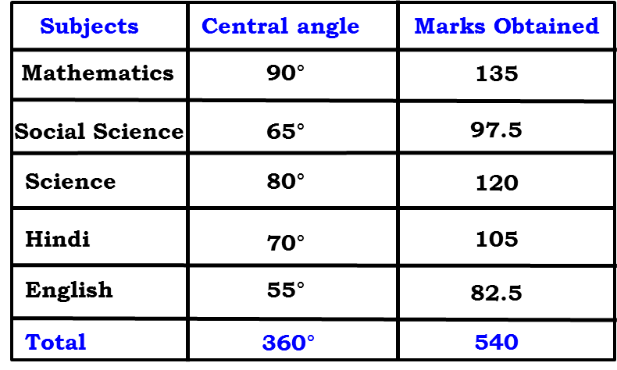
Q.
The adjoining pie chart gives the marks scored in an examination by a student in Hindi, English, Mathematics, Social Science and Science.
If the total marks obtained by a student was 540, answer The following questions:
(i) In which subject did the student score 105 marks?
Sol.
(i) The student scored 105 marks in Hindi.

Slide 45
Q.
The adjoining pie chart gives the marks scored in an examination by a student in Hindi, English, Mathematics, Social Science and Science.
If the total marks obtained by a student was 540, answer The following questions:
(ii) How many more marks were obtained by the student in Mathematics
than in Hindi?
Sol.
(ii) Marks obtained in Mathematics
=
135
Marks obtained in Hindi
=
105
Difference
=
135
–
105
=
30
Thus, 30 more marks were obtained by the
student in Mathematics than in Hindi.

Slide 46
Q.
The adjoining pie chart gives the marks scored in an examination by a student in Hindi, English, Mathematics, Social Science and Science.
If the total marks obtained by a student was 540, answer The following questions:
(iii) Examine whether the sum of the marks obtained in Social Science
and Mathematics is more than that in Science and Hindi.
Sol.
(iii) The sum of marks in Social Science
and Mathematics =
135
+
97.5
=
232.5
The sum of marks in Science and Hindi
=
120
+
105
=
225
Yes, the sum of the marks in Social Science
and Mathematics is more than that in science
and Hindi.

Slide 47
Module 14

Slide 48
Q.
A survey was made to find the type of music that a certain group
of young people liked in a city. Adjoining pie chart shows the
findings of this survey. From this pie chart, answer the following:
If 20 people liked classical music, how many young people were surveyed?
Which type of music is liked by the maximum number of people?
(iii) If a cassette company were to make 1000 CD’s, how many of each type would they make?
Sol:
(i) 10% represents 20 people.
Let Total Number of people surveyed be ‘x’
∴
10% of x is
20
Semi-Classical
20%
40%
10
Light
∴
×
x
=
20
10%
100
Classical
30%
20
×
Folk
100
∴
x
=
10
∴
x
=
200
Hence, 200 people were surveyed.

Slide 49
Q.
A survey was made to find the type of music that a certain group
of young people liked in a city. Adjoining pie chart shows the
findings of this survey. From this pie chart, answer the following:
If 20 people liked classical music, how many young people were surveyed?
Which type of music is liked by the maximum number of people?
(iii) If a cassette company were to make 1000 CD’s, how many of each type would they make?
Sol:
(ii) Light music is liked by the
maximum number of people.
Semi-Classical
20%
40%
(iii) CD’s of classical music
=
10% of 1000
Light
10%
10
Classical
=
×
1000
=
100
30%
100
Folk
CD’s of semi-classical music
=
20% of 1000
20
=
×
1000
=
200
100

Slide 50
Q.
A survey was made to find the type of music that a certain group
of young people liked in a city. Adjoining pie chart shows the
findings of this survey. From this pie chart, answer the following:
If 20 people liked classical music, how many young people were surveyed?
Which type of music is liked by the maximum number of people?
(iii) If a cassette company were to make 1000 CD’s, how many of each type would they make?
Sol:
CD’s of light music
=
40% of 1000
40
Semi Classical
×
20%
=
1000
=
400
40%
100
Light
10%
CD’s of folk music
=
30% of 1000
Classical
30%
Folk
30
=
×
1000
=
300
100

Slide 51
Lecture3

Slide 52
Module 15

Slide 53

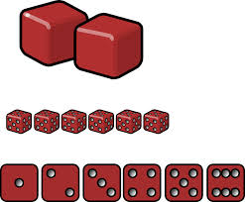
Random Experiment :
It is an experiment in which all the possible
results are known in advance but they cannot be predicted with certainty.
For eg : Rolling of a Die
1,
2,
3,
4,
5,
6
Possible Results
The result of a random experiment.
Outcome
Number of all possible outcomes = 6
Here, we assume that each outcome is likely to occur equally as other.

Slide 54
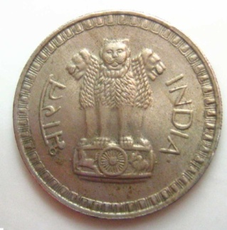
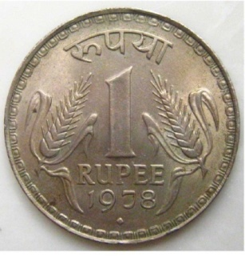
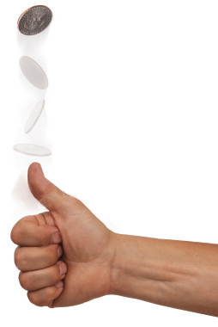
A Coin is Tossed
H
T
All possible outcomes are H, T
Number of all possible outcomes = 2

Slide 55
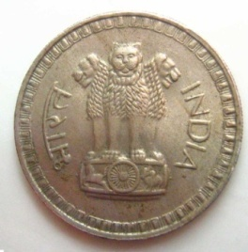

2 Coins are Tossed Together
Result on first coin
Result on first coin
Result on second coin
Result on second coin
Result on first coin
Result on first coin
Result on second coin
Result on second coin
HH, HT, TH, TT
Number of all possible outcomes = 4

Slide 56

Game Of Chance :
8
1
7
2
6
3
5
4
All possible outcomes are 1, 2, 3, 4, 5, 6, 7, 8
Number of all possible outcomes = 8
On whichever number the arrow points that number is taken as an outcome of that experiment.

Slide 57
Module 16

Slide 58
Event - Set of Favourable outcomes.
Something that you wish should happen / should not happen.
For example:
Let us assume a situation we are watching an India v/s Australia match. And 1 ball is remaining and 5 runs are required to win.
All possible Outcomes are – Win, Lose, Draw
Events are denoted by Capital Letters
Let A be the event that INDIA wins
A = Win
Let B be the event that INDIA does not lose
B = Win, Draw

Slide 59
PROBABILITY OF AN EVENT
Number of outcomes favourable to E
P(E) =
Number of all possible outcomes of the experiment
An event is denoted by capital letter.
Bracket stands for of
P stands for probability

Slide 60
Module 17

Slide 61
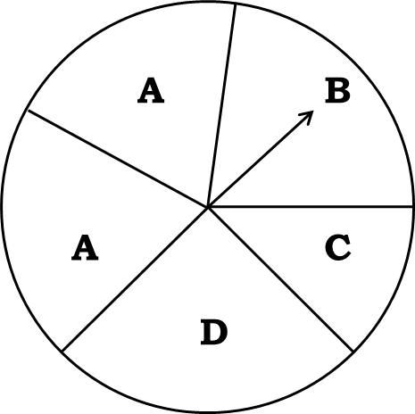
Q.
List the outcomes you can see in these experiments.
(a) Spinning a wheel
(b) Tossing two coins together
A
B
A
C
D
Sol:
(a)
When a wheel is spun.
The possible outcomes are
A,
A,
B,
C,
D.
(b)
When two coins are tossed together.
The possible outcomes are
HH,
HT,
TH,
TT.

Slide 62
Q.
When a die is thrown, list the outcomes of an event of getting:
(i) (a) a prime number
(b) not a prime number
(ii) (a) a number greater than 5
(b) a number not greater than 5
Sol:
When a die is thrown,
All the possible outcomes are 1, 2, 3, 4, 5, 6
(i)
(a) Let A be the event of getting a prime number.
Outcomes favourable to A are
2, 3, 5.
(b) Let B be the event of getting not a prime number.
Outcomes favourable to B are
1, 4, 6.
(ii)
(a) Let C be the event of getting a number greater than 5.
Outcome favourable to C is
6.
(b) Let D be the event of getting a number not greater than 5.
Outcomes favourable to D are
1, 2, 3, 4, 5.

Slide 63
Q.
Find the Probability of the pointer stopping on D.
A
B
Sol:
When a wheel is spun.
The possible outcomes are A, A, B, C, D.
A
C
Total number of outcomes =
5
D
Let A be the event of pointer stopping on D.
∴ Number of outcome = 1
Number of outcomes favourable to A
∴
P(A) =
Total number of possible outcomes
1
∴
P(A) =
5
∴
1
The probability of pointer stopping at D is
5

Slide 64
Module 18

Slide 65
Q.
Find the Probability of getting an ace from a well shuffled
deck of 52 playing cards.
Sol:
The total number possible outcomes = 52
Let A be the event of getting an ace card.
There are 4 aces in a deck of 52 playing cards.
∴
Number of outcome = 4
Number of outcomes favourable to A
∴
P(A) =
Total number of possible outcomes
4
∴
P(A) =
52
1
∴
P(A) =
13
∴
The probability of getting ace card is
1
13

Slide 66


Q.
Find the Probability of getting a red apple.
Sol:
Total number of apples = 7
Let A be the event of getting a red apple.
Total number of red apples =
4
Number of outcomes favourable to A
∴
P(A) =
Total number of possible outcomes
4
∴
P(A) =
7
∴
4
The probability of getting a red apple is
7

Slide 67
Module 19

Slide 68
Q.
Numbers 1 to 10 are written on ten separate slips (one number on one slip), kept in a box and mixed well. One slip is chosen from the box without looking into it. What is the probability of:
(i) getting a number 6.
Sol:
When slip is chosen from the box,
All the possible outcomes are 1, 2, 3, 4, 5, 6, 7, 8, 9, 10.
Total no. of possible outcomes =
10
Let A be the event of getting a number 6.
Outcome favourable to A is 6
∴ No. of outcomes favourable to A =
1
Number of outcomes favourable to A
∴
P(A) =
Total number of possible outcomes
1
∴
P(A) =
10

Slide 69
Q.
Numbers 1 to 10 are written on ten separate slips (one number on one slip), kept in a box and mixed well. One slip is chosen from the box without looking into it. What is the probability of:
(ii) getting a number less than 6.
Sol:
When slip is chosen from the box,
All the possible outcomes are 1, 2, 3, 4, 5, 6, 7, 8, 9, 10.
Total no. of possible outcomes =
10
Let B be the event of getting a number less than 6.
Outcomes favourable to B are 1, 2, 3, 4, 5.
∴ No. of outcomes favourable to B =
5
Number of outcomes favourable to B
∴
P(B) =
Total number of possible outcomes
5
∴
P(B) =
10
1
∴
P(B) =
2

Slide 70
Q.
Numbers 1 to 10 are written on ten separate slips (one number on one slip), kept in a box and mixed well. One slip is chosen from the box without looking into it. What is the probability of:
(iii) getting a number greater than 6.
Sol:
When slip is chosen from the box,
All the possible outcomes are 1, 2, 3, 4, 5, 6, 7, 8, 9, 10.
Total no. of possible outcomes =
10
(ii) Let C be the event of getting a number greater than 6.
Outcomes favourable to C are 7, 8, 9, 10.
∴ No. of outcomes favourable to C =
4
Number of outcomes favourable to C
∴
P(C) =
Total number of possible outcomes
4
∴
P(C) =
10
2
∴
P(C) =
5

Slide 71
Q.
Numbers 1 to 10 are written on ten separate slips (one number on one slip), kept in a box and mixed well. One slip is chosen from the box without looking into it. What is the probability of:
(iv) getting a 1-digit number.
Sol:
When slip is chosen from the box,
All the possible outcomes are 1, 2, 3, 4, 5, 6, 7, 8, 9, 10.
Total no. of possible outcomes =
10
(ii) Let D be the event of getting a 1-digit number.
Outcomes favourable to D are 1, 2, 3, 4, 5, 6, 7, 8, 9.
∴ No. of outcomes favourable to D =
9
Number of outcomes favourable to D
∴
P(D) =
Total number of possible outcomes
9
∴
P(D) =
10

Slide 72
Module 20

Slide 73
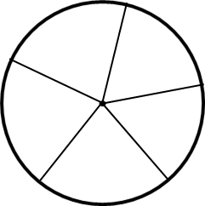
Q.
If you have a spinning wheel with 3 green sectors, 1 blue sector and 1 red sector, what is the probability of getting :
(i) a green sector
(ii) a none-blue sector
5
3
4
Sol:
There are five sectors,
1
1
3
∴
Possible outcomes is 5.
2
(i) Let A be the event of getting green sector.
Number of outcomes favourable to A is 3.
Number of outcomes favourable to A
∴
P(A) =
Total number of possible outcomes
3
∴
P(A) =
5
∴
3
The probability of getting green sector is
5

Slide 74
Q.
If you have a spinning wheel with 3 green sectors, 1 blue sector and 1 red sector, what is the probability of getting :
(i) a green sector
(ii) a none-blue sector
Sol:
There are five sectors,
∴
Possible outcomes is 5.
(ii) Let B be the event of getting non – blue sector.
There is one blue sector out of five sectors.
Non – blue sector =
5
–
1 =
4
Number of outcomes favourable to B is 4.
Number of outcomes favourable to B
∴
P(B) =
Total number of possible outcomes
4
∴
P(B) =
5
∴
The probability of getting non – blue is
4
5

Slide 75
Module 21

Slide 76
Q.
When a die is thrown, find the probability of getting:
(i) (a) a prime number
(b) not a prime number
(ii) (a) a number greater than 5
(b) a number not greater than 5
Sol:
When a die is thrown,
All the possible outcomes are 1, 2, 3, 4, 5, 6
Total no. of possible outcomes =
6
(i) (a) Let A be the event of getting a prime number.
Outcomes favourable to A are 2, 3, 5
∴ No. of outcomes favourable to A =
3
Number of outcomes favourable to A
∴
P(A) =
Total number of possible outcomes
3
∴
P(A) =
6
1
∴
P(A)
=
2

Slide 77
Q.
When a die is thrown, find the probability of getting:
(i) (a) a prime number
(b) not a prime number
(ii) (a) a number greater than 5
(b) a number not greater than 5
Sol:
When a die is thrown,
All the possible outcomes are 1, 2, 3, 4, 5, 6
Total no. of possible outcomes =
6
(i) (b) Let B be the event of getting not a prime number.
Outcomes favourable to B are 1, 4, 6.
∴ No. of outcomes favourable to B =
3
Number of outcomes favourable to B
∴
P(B) =
Total number of possible outcomes
3
∴
P(B) =
6
1
∴
P(B)
=
2

Slide 78
Q.
When a die is thrown, find the probability of getting:
(i) (a) a prime number
(b) not a prime number
(ii) (a) a number greater than 5
(b) a number not greater than 5
Sol:
When a die is thrown,
All the possible outcomes are 1, 2, 3, 4, 5, 6
Total no. of possible outcomes =
6
(ii) (a) Let C be the event of getting a number greater than 5.
Outcome favourable to C is 6.
∴ No. of outcomes favourable to C =
1
Number of outcomes favourable to C
∴
P(C) =
Total number of possible outcomes
1
∴
P(C) =
6

Slide 79
Q.
When a die is thrown, find the probability of getting:
(i) (a) a prime number
(b) not a prime number
(ii) (a) a number greater than 5
(b) a number not greater than 5
Sol:
When a die is thrown,
All the possible outcomes are 1, 2, 3, 4, 5, 6
Total no. of possible outcomes =
6
(ii) (b) Let D be the event of not getting a number greater than 5.
Outcomes favourable to D are 1, 2, 3, 4, 5.
∴ No. of outcomes favourable to D =
5
Number of outcomes favourable to D
∴
P(D) =
Total number of possible outcomes
5
∴
P(D) =
6

